Slide 1
Azure Service Bus

Slide 2
Agenda
What is Service Bus
Architecture
Why Service Bus
Features
Bus Services

Slide 3
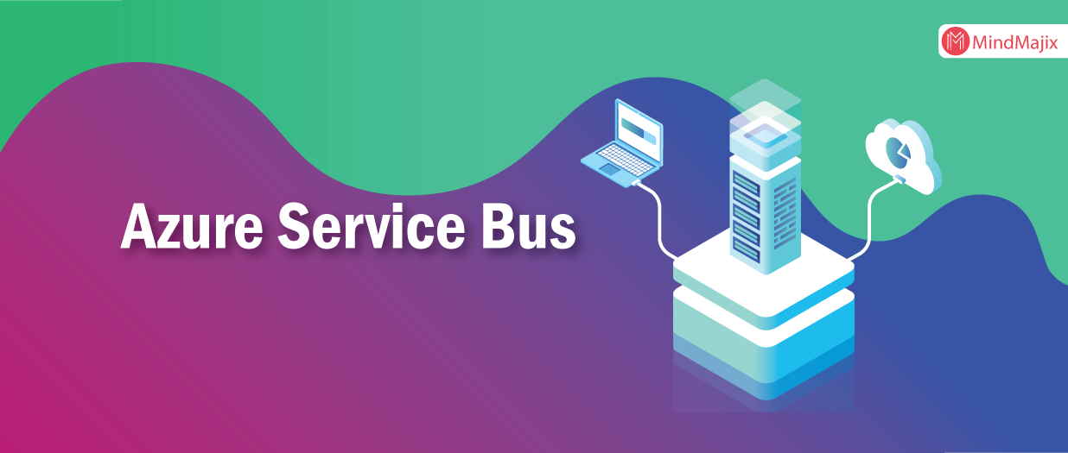
What is Azure service bus
SOA (software-oriented architecture) proposes a design for software implementations where these components can communicate with each other by application components through communication protocol over a network.
These application components can be visualized as Service Bus .
Azure Service Bus is a fully managed multi-tenant cloud messaging service (MAAS).
It is brokered messaging system. Applications and services can communicate with each other using messages via Service Bus.
Message consists of two parts; message properties and message payload. Message properties is a dictionary of values against property keys.
Message payload is in binary format, which can contain JSON, XML, or text data.

Slide 4
Architecture
Azure Service Bus offers three types of communication mechanisms; queues, topics and, relays.
Queues and Topics, facilitate one-directional communication. Messages will be stored until they are consumed.
Each message in Queue is received by a single recipient. Topic can have multiple subscriptions for multiple receivers. Subscriptions can choose to receive messages based on parameters.
Messages from Queues and Topics can be accessed using Service bus-defined messaging APIs or REST APIs. SDKs are also available for other languages. Unlike Queues and Topics; Relays provide bi-directional communication and does not store messages.

Slide 5
Why Service Bus ?
As Azure Service Bus is fully managed service, scaling and availability will be taken care by Azure team.
It is integrated with other Azure services like, Event Grid, Logic Apps, Stream Analytics etc.
Azure Service Bus provides reliable and secure asynchronous message communication platform along with facility of delayed processing of events or data.
Shared Access Signatures (SAS), Role Based Access Control (RBAC) and Managed Service Identity (MSI) protocols are supported by it.
Service Bus also supports client libraries for . Net ,Java.

Slide 6
Service Bus Tier Features:
Standard tier
It can be used for initial development and QA environment deployments. Latency and throughput in Standard tier are variable, hence performance is not predictable. In built scaling is also not available and maximum message size is upto 256 kb.
Premium tier
It can be used for Production deployments. It provides high throughput and auto scaling for variable workloads. Maximum message size can be up to 1mb. Premium name spaces provides CPU and memory level isolation for resources. Performance of Premium tier resources at peak load is much faster than Standard ones.

Slide 7
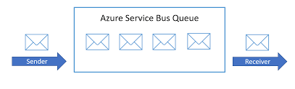
Service Bus Services
Queues :
As name suggest, Queues messaging service offers First In First Out data delivery.
It enables ordered handling of unbounded sequences of related messages. Message sessions is used to ensure a first-in, first-out (FIFO).
Queues enable us to store messages until the receiving application is available to receive and process them.
Messages are delivered on request (Pull mode delivery). Queue is often used for point-to-point communication.

Slide 8
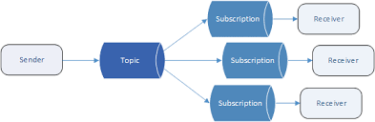
Topics:
Topics is nothing but single input queue but multiple output queues.
Output queues are nothing but Subscriptions. Receiving apps needs to create subscriptions to receive messages from Topic.
Subscription can filter out the messages based on rules on message properties.
Publish/subscribe scenarios can be implemented using Topics.

Slide 9
Relays:
Azure provides Relay messaging service. In Queues or Topics there is no explicit connection between sender and receiver. However, for relays, each application will create outbound TCP connection to Service Bus. All communication happens using WCF (Windows communication Foundation).
We do not need to create relays explicitly. Relay will be created when application established connection to Service Bus. Idea of providing Relay method is to connect applications irrespective of their deployment environment.

Slide 10
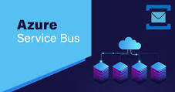
Summary:
Service Bus Messaging service has a lot to offer, we cannot cover its all capabilities in single article.
There are Paired Namespaces, AMQP support, Partitioned Queues and many more.
In short, Azure Service Bus helps us to build our loosely coupled software components with less deployment efforts and with high Scalability and Availability of communication.
By providing three different types of services, it enables architect/developer to implement different communication scenarios.

Slide 11
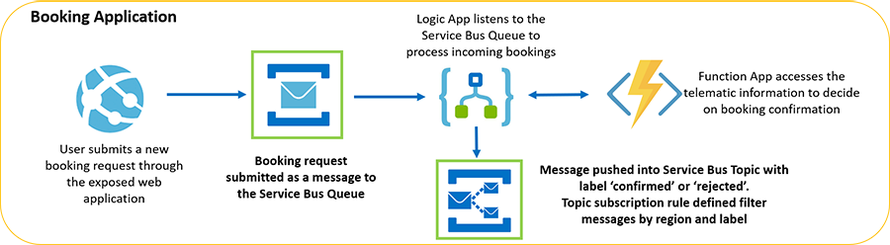
Overview:

Slide 12
Thank you

